Slide 1
METHOD OF PROOF
SESSION 7
Course : Z0184-Discrete Mathematics
Effective Period : September 2017

Slide 2
These slides have been adapted from :
Susanna S.Epp. (2010). Discrete Mathematics with Applications.4th edition. Thomson Brooks/Cole. USA. ISBN: 9780534359454
Chapter 4
Acknowledgement

Slide 3
On successful completion of this Course, students will be able to:
Learning Objectives
LO 1: Explain the logic of compound and quantified statements and how do to proof
LO 2: Explain and applying Set Theory, Counting method and Number Theory
LO 3: Explain Function, recursion, fuzzy set, Relations and Graph Theory
LO 4: Explain Trees & Graph theory and its application
LO 5: Explain Automata and graph its application in computer science

Slide 4
Direct Proof
Mathematics, as a science, commenced when first someone, probably a Greek, proved propositions about “any” things or about “some” things without specification of definite particular things.
— Alfred North Whitehead, 1861–1947

Slide 5
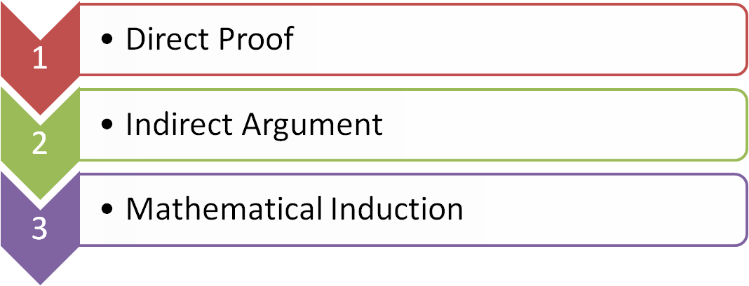
Outline

Slide 6
DIRECT PROOF

Slide 7
Direct Proof
Method of Direct Proof
1. Express the statement to be proved in the form “∀x ∈ D, if P(x) then Q(x).” (This step is often done mentally.)
2. Start the proof by supposing x is a particular but arbitrarily chosen element of D for which the hypothesis P(x) is true. (This step is often abbreviated “Suppose x ∈ D and P(x).”)
3. Show that the conclusion Q(x) is true by using definitions, previously established results, and the rules for logical inference.

Slide 8
Example : Direct Proof
If n is even, then n² is even.
Proof:
n is even, so n = 2k, where k is integer.
So that, n² = (2k)² = 4k²
= 2(2k²)
= 2m, where m = 2k², m also integer
We conclude that n² is even

Slide 9


Example : Direct Proof
The sum of any two rational numbers is rational.
Proof:
Suppose r and s are rational numbers. [We must show that r + s is rational.] Then, by definition of rational, r=a/b, and s= c/d. for some integers a, b, c, and d with b 0, d 0. Thus

Slide 10
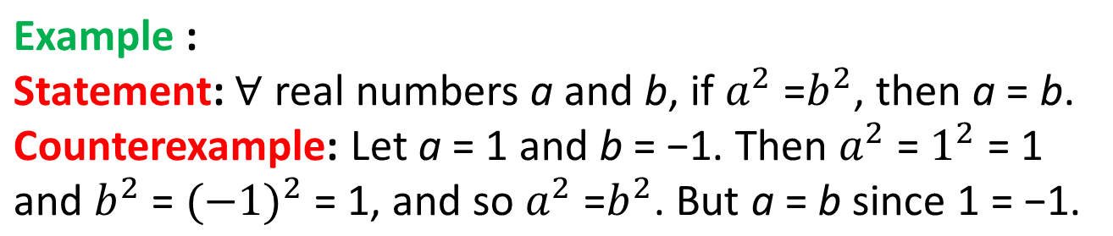
Counterexample (1)
To disprove a statement of the form “∀x ∈ D, if P(x) then Q(x),” find a value of x in D for which the hypothesis P(x) is true and the conclusion Q(x) is false. Such an x is called a counterexample.

Slide 11
Counterexample (2)
Statement:
For all integers a and b, if a|b and b|a then a = b.
Counterexample:
Let a = 2 and b = - 2. Then a|b since 2|(-2) and b|a since
(-2) | 2, but a ≠ b since 2 ≠ -2.
Therefore, the proposed divisibility property is false.

Slide 12
Counterexample (3)
Statement:
For all integers a and b, if a|b and b|a then a = b.
Counterexample:
Let a = 2 and b = - 2. Then a|b since 2|(-2) and b|a since
(-2) | 2, but a ≠ b since 2 ≠ -2.
Therefore, the proposed divisibility property is false.

Slide 13
INDIRECT ARGUMENT

Slide 14
Contradiction
Method of Proof by Contradiction
1. Suppose the statement to be proved is false. That is, suppose that the negation of the statement is true.
2. Show that this supposition leads logically to a contradiction.
3. Conclude that the statement to be proved is true.

Slide 15

Example : Contradiction
The sum of any rational number and any irrational number is irrational.
Proof :
[We take the negation of the theorem and suppose it to be true.] Suppose not. That is,suppose there is a rational number r and an irrational number s such that r + s is rational. [We must deduce a contradiction.]. By definition of rational, r=a/b, and s= c/d. for some integers a, b, c, and d with b 0, d 0. By substitution,

Slide 16

Example : Contradiction
And so
Now bc − ad and bd are both integers [since a, b, c, and d are integers and since products and differences of integers are integers], and bd = 0 [by the zero product property]. Hence s is a quotient of the two integers bc − ad and bd with bd = 0. Thus, by definition of rational, s is rational, which contradicts the supposition that s is irrational. [Hence the supposition is false and the theorem is true.]

Slide 17
Contraposition
Method of Proof by Contraposition :
Express the statement to be proved in the form
∀x in D, if P(x) then Q(x).
(This step may be done mentally.)
2. Rewrite this statement in the contrapositive form
∀x in D, if Q(x) is false then P(x) is false.
(This step may also be done mentally.)
Prove the contrapositive by a direct proof.
a. Suppose x is a (particular but arbitrarily chosen) element of D such that Q(x) is false.
b. Show that P(x) is false.

Slide 18
Example: Contraposition
For all integers n, if n² is even then n is even.
Proof (by contraposition):
Suppose n is any odd integer. [We must show that n² is odd.] By definition of odd, n = 2k + 1 for some integer k.
By substitution and algebra,
n² = (2k + l)² = 4k² + 4k + 1 = 2(2k² + 2k) + 1.
But 2k² + 2k is an integer because products and sums of integers are integers. So n² = 2(an integer) + 1, and thus,
by definition of odd, n² is odd [as was to be shown].

Slide 19
MATHEMATICAL INDUCTION

Slide 20
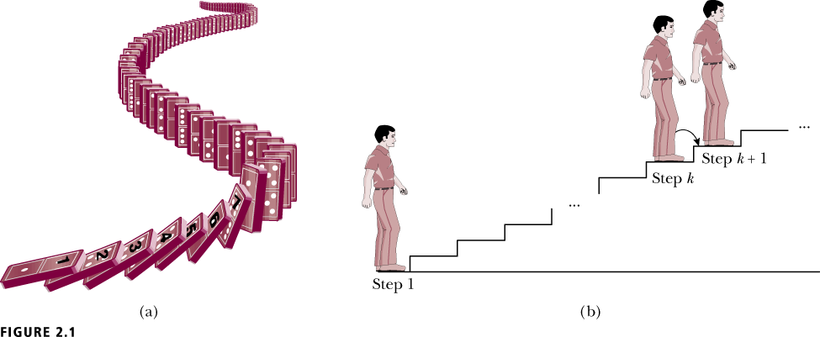
Mathematical Induction
Assume that when a domino is knocked over, the next domino is knocked over by it
Show that if the first domino is knocked over, then all the dominoes will be knocked over

Slide 21

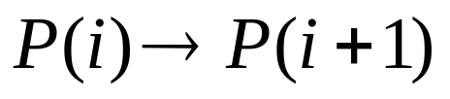
Mathematical Induction
Let P(n) denote the statement that then n^{th} domino is knocked over
Base Step: Show that P(1) is true
Inductive Hypothesis: Assume some P(i) is true, i.e. the i^{th} domino is knocked over for some
Inductive Step: Prove that P(i+1) is true, i.e.

Slide 22


Example: Mathematical
Induction (1/4)
Use mathematical induction to prove that
for all integers n ≥ 1.
Proof :
Let the property P(n) be the equation

Slide 23


Example: Mathematical
Induction (2/4)
Show that P(1) is true:
To establish P(1), we must show that
But the left-hand side of this equation is 1 and the right-hand side is
also. Hence P(1) is true.

Slide 24



Example: Mathematical
Induction (3/4)
Show that for all integers k ≥ 1, if P(k) is true then P(k + 1) is also true:

Slide 25
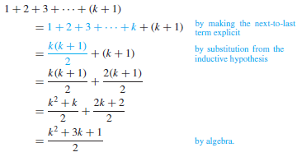

Example: Mathematical
Induction (3/4)
The left-hand side of P(k + 1) is
And the right-hand side of P(k + 1) is
Therefore the equation P(k + 1) is true [as was to be shown].

Slide 26
Reference
Susanna S.Epp. (2015). Discrete Mathematics with Applications.5th edition. Thomson Brooks/Cole. USA. ISBN: 9780534359454

